Slide 1
C decision making

Slide 2
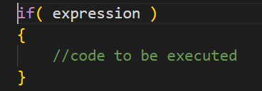
Decision making
In C language, if-else and switch statements used to perform the operations based on some specific condition. The operations specific in if block are executed if and only if given conditions is true.
If Statement:
The if statement is used to check some given condition and perform some operations depending upon the correctness
of that condition. It is mostly used in the scenario where we need to perform the different operations for the different
conditions. The syntax of the if statement is given below.

Slide 3
Flowchart of it statement in c
Condition
False
true
if code
After if

Slide 4
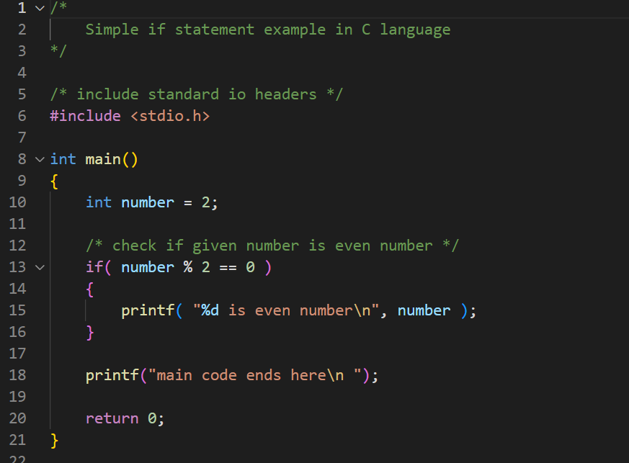

Let’s see a simple example on if statement
Output

Slide 5
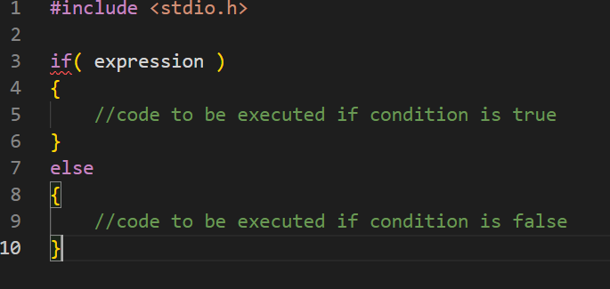
If else statement
The if-else statement is used to perform two operations for a single condition. The if-else statement is an extension to the if statement using which, we can perform two different operations, i.e., one is for the correctness of that condition, and the other is for the incorrectness of the condition. Here, we must notice that if and else block cannot be executed simultaneously. Using if-else statement is always preferable since it always invokes an otherwise case with every if condition. The syntax of the if-else statement is given below.

Slide 6
If else flow chart
Condition
false
true
If code
Else code
After if

Slide 7
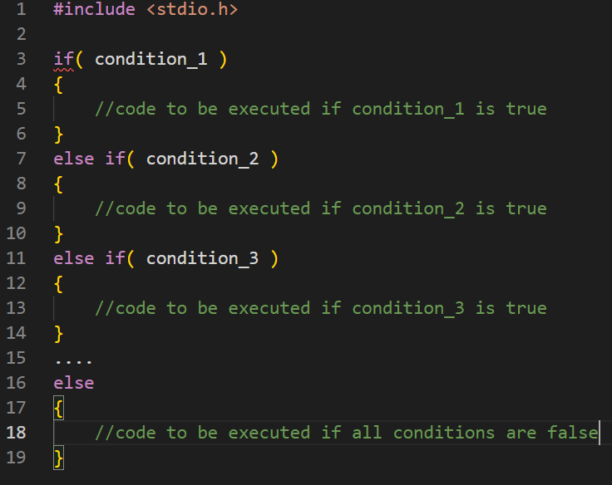
If else-if ladder statement
The if-else-if ladder statement is an extension to the if-else statement. It is used in the scenario where there are multiple cases to be performed for different conditions. In if-else-if ladder statement, if a condition is true then the statements defined in the if block will be executed, otherwise if some other condition is true then the statements defined in the else-if block will be executed, at the last if none of the condition is true then the statements defined in the else block will be executed. There are multiple else-if blocks possible. It is similar to the switch case statement where the default is executed instead of else block if none of the cases is matched.

Slide 8
If else-if flow chart
Condition1
Condition2
Condition
N
false
false
false
true
true
true
Statement 1
Statement 2
Statement N
Statement false
After if

Slide 9
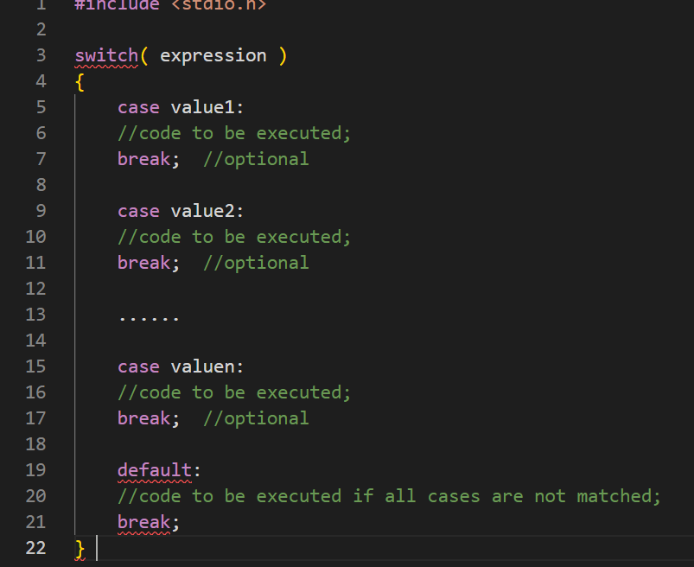
Switch statement
The switch statement in C is an alternate to if-else-if ladder statement which allows us to execute multiple operations for the different possible values of a single variable called switch variable. Here, We can define various statements in the multiple cases for the different values of a single variable.

Slide 10
Rules for switch statement in C language
The switch expression must be of an integer or character type.
The case value must be an integer or character constant.
The case value can be used only inside the switch statement.
The break statement in switch case is not must. It is optional. If there is no break statement found in the case, all the cases will be executed present after the matched case. It is known as fall through the state of C switch statement.

Slide 11
Flowchart of switch statement in C
Condition1
Statement 1
break
Condition2
Statement 2
break
Condition3
Statement 3
break
Condition3
Statement n
break

